Slide 1
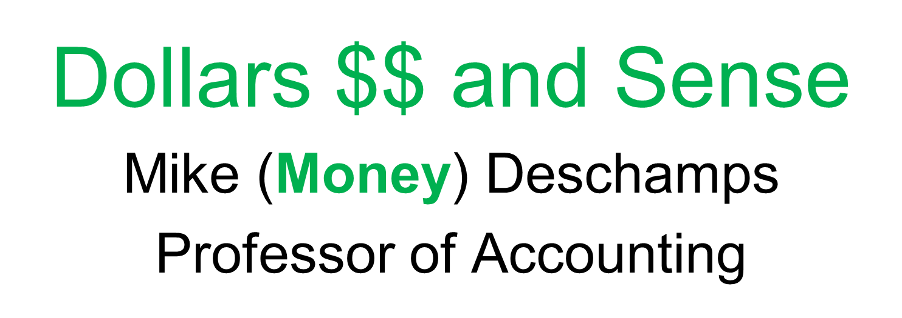

Slide 2
Why Accounting?
Financial Literacy – what does that mean?
What does taxation have to do with me?
What can a career in accounting do for me?

Slide 3
Financial Literacy
Definition - is the ability to understand how money works in the world: how someone manages to earn or make it, how that person manages it, how he/she invests it (turn it into more) and how that person donates it to help others.

Slide 4
Financial Literacy Crisis
Flunking - Most Americans have extremely low levels of financial literacy, research suggests, despite its importance.
https://www.youtube.com/watch?v=21PuqepQ5Hk

Slide 5
Financial Literacy
BUS 147: Personal Finance
This course assists students in gaining the knowledge, tools, attitude, and skills needed to make informed lifelong financial decisions that will empower their lives.

Slide 6
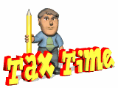
Introduction to Taxation
An income tax was first enacted in 1861 and repealed after the Civil War ended
An income tax law was passed in 1894 and was rejected by the Supreme Court in 1895.
Sixteenth Amendment to the Constitution was passed in 1913
  This is the basis of modern income tax law
Notes:
6
The first income tax was enacted almost 150 years ago. It was not until a constitutional amendment was enacted in 1913 that the individual income tax became a reality. Much of the Internal Revenue Code has its legal foundation in the 16th Amendment.

Slide 7

Taxation
About 145.6 million individual income tax returns were filed in 2011
  Almost 83% were filed electronically
Individual income tax collections were about $1.04 trillion in 2011 – Uncle Sam took a lot of your money!!
Notes:
7
Electronic filing has now grown to about 83% of all tax returns.
Tax collections from individuals make up the largest part of total tax collections.

Slide 8
Taxation
But, if you can help people reduce the amount of money that they pay to the government – they will pay you!!
Making good by doing good

Slide 9

Taxation
Become a California Registered Tax Preparer (CRTP) – meaning that you can charge $$$$ for doing returns - just by taking just one class here at MiraCosta College
ACCT 145 – Individual Income Tax

Slide 10
The Income Tax Formula
Income
− Permitted Deductions from Income
--------------------------------
= Taxable Income
× Appropriate Tax Rates
--------------------------------
= Tax Liability
− Tax Payments and Tax Credits
---------------------------------
= Tax Refund or Tax Due with Return
Notes:
10
This is the basic income tax formula. All individual income tax returns are based on this formula. As the complexity of the tax situation of an individual increases, this formula becomes more complicated, but the basic structure remains the same. We will show you a more complex formula in chapter 2.

Slide 11
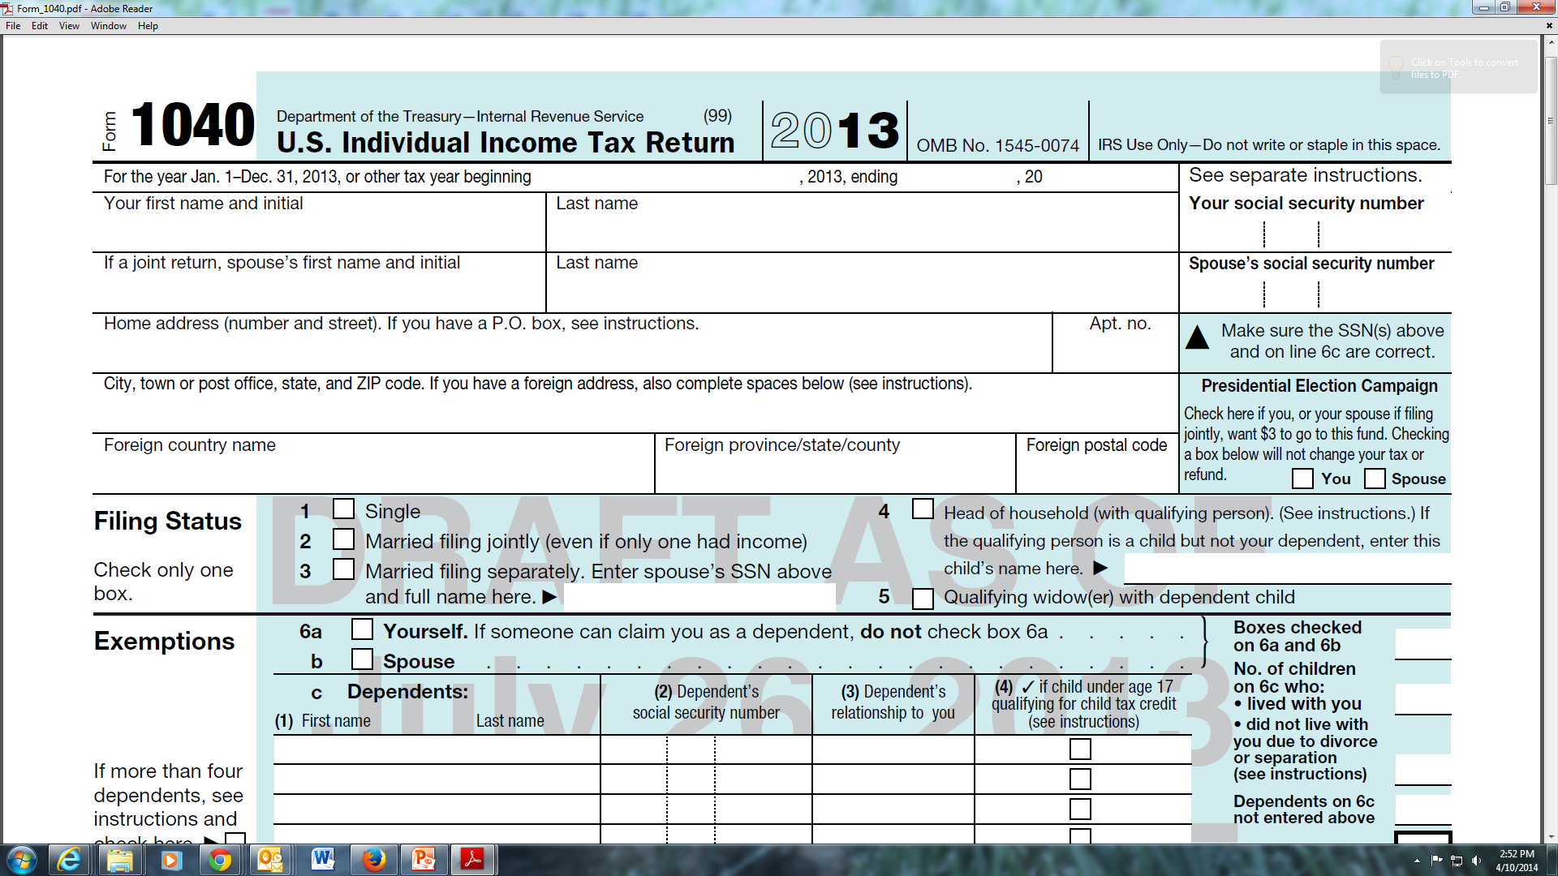

Slide 12
Taxation
Taxpayers annually file a tax return using
  Form 1040
  Form 1040A
  Form 1040EZ
All follow the basic income tax formula
And then there are the State returns as well – can you say bank!
Notes:
12
There are three tax forms on which a taxpayer can report their income and deductions to the Internal Revenue Service. The most complex is a Form 1040, the least complex is a 1040EZ, and a 1040A is in the middle. All taxpayers can file a Form 1040. However, some taxpayers may be able to file using a simpler form.

Slide 13
Accounting Careers
CPA – Certified Public Accountant
  Internationally recognized certification
  Can lead to may exciting and well paying career opportunities
  Average starting salary in San Diego for an accounting major with a BS degree >$52K
Other accounting certifications:
  Certified Management Accountant (CMA)
  Certified Internal Auditor (CIA)

Slide 14
Accounting Careers
https://www.youtube.com/watch?v=9I502zLYZXU

Slide 15

Why Accounting?

